Slide 1
Data Mining: Concepts and Techniques (3rd ed.) — Chapter 6 —
Jiawei Han, Micheline Kamber, and Jian Pei
University of Illinois at Urbana-Champaign &
Simon Fraser University
©2011 Han, Kamber & Pei. All rights reserved.
1
Notes:
1

Slide 2
Chapter 5: Mining Frequent Patterns, Association and Correlations: Basic Concepts and Methods
Basic Concepts
Frequent Itemset Mining Methods
Which Patterns Are Interesting?—Pattern Evaluation Methods
Summary

Slide 3
What Is Frequent Pattern Analysis?
Frequent patterns are patterns (e.g., itemsets, subsequences, or substructures) that appear frequently in a data set.
A set of items, such as milk and bread, that appear frequently together in a transaction data set is a frequent itemset.
A subsequence, such as buying first a PC, then a digital camera, and then a memory card, if it occurs frequently in a shopping history database, is a (frequent) sequential pattern.
A substructure can refer to different structural forms, such as subgraphs, subtrees, or sublattices, which may be combined with itemsets or subsequences. If a substructure occurs frequently, it is called a (frequent) structured pattern. Finding frequent patterns plays an essential role in mining associations, correlations, and many other interesting relationships among data.
Moreover, it helps in data classification, clustering, and other data mining tasks. Thus, frequent pattern mining has become an important data mining task and a focused theme in data mining research.

Slide 4
What Is Frequent Pattern Analysis?..
First proposed by Agrawal, Imielinski, and Swami [AIS93] in the context of frequent itemsets and association rule mining
Motivation: Finding inherent regularities in data
What products were often purchased together?— Beer and diapers?
What are the subsequent purchases after buying a PC?
What kinds of DNA are sensitive to this new drug?
Can we automatically classify web documents?
Applications
Basket data analysis, cross-marketing, catalog design, sale campaign analysis, Web log (click stream) analysis, and DNA sequence analysis.

Slide 5
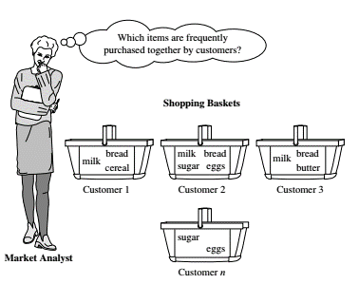
Market Basket Analysis

Slide 6
Why Is Freq. Pattern Mining Important?
Freq. pattern: An intrinsic and important property of datasets
Foundation for many essential data mining tasks
Association, correlation, and causality analysis
Sequential, structural (e.g., sub-graph) patterns
Pattern analysis in spatiotemporal, multimedia, time-series, and stream data
Classification: discriminative, frequent pattern analysis
Cluster analysis: frequent pattern-based clustering
Data warehousing
Semantic data compression: fascicles
Broad applications

Slide 7
Support and Confidence
Rule support and confidence are two measures of rule interestingness. They respectively reflect the usefulness and certainty of discovered rules.
A support of 2% for above Rule means that 2% of all the transactions under analysis show that computer and antivirus software are purchased together.
A confidence of 60% means that 60% of the customers who purchased a computer also bought the software.
Typically, association rules are considered interesting if they satisfy both a minimum support threshold and a minimum confidence threshold.
These thresholds can be a set by users or domain experts. Additional analysis can be performed to discover interesting statistical correlations between associated items.

Slide 8
Basic Concepts: Frequent Patterns
itemset: A set of one or more items
k-itemset X = {x₁, …, x_{k}}
(absolute) support, or, support count of X: Frequency or occurrence of an itemset X, like bear=3, diaper=4, nuts=?
(relative) support, s, is the fraction of transactions that contains X (i.e., the probability that a transaction contains X) like beer=3/5,diaper=4/5, nuts=?
An itemset X is frequent if X’s support is no less than a minsup threshold
Tid | Items bought
10 | Beer, Nuts, Diaper
20 | Beer, Coffee, Diaper
30 | Beer, Diaper, Eggs
40 | Nuts, Eggs, Milk
50 | Nuts, Coffee, Diaper, Eggs, Milk
Customer
buys both
Customer
buys diaper
Customer
buys beer

Slide 9
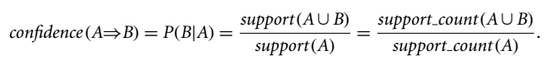
Basic Concepts: Association Rules
Tid
Items bought
Find all the rules X → Y with minimum support and confidence
support, s, probability that a transaction contains X ∪ Y
confidence, c, conditional probability that a transaction having X also contains Y
Let minsup = 50%, minconf = 50%
Freq. Pat.: Beer:3, Nuts:3, Diaper:4, Eggs:3, {Beer, Diaper}:3
10
Beer, Nuts, Diaper
20
Beer, Coffee, Diaper
30
Beer, Diaper, Eggs
40
Nuts, Eggs, Milk
50
Nuts, Coffee, Diaper, Eggs, Milk
Customer
buys both
Customer
buys diaper
Customer
buys beer
Association rules: (many more!)
Beer → Diaper (60%, 100%)
Diaper → Beer (60%, 75%)
Milk→Nuts (s=?,c=?)
Nuts→ Milk (s=?,c=?)
Egg→milk (s=?,c=?)
Milk→Egg (s=?,c=?)
Notes:
Milk→Nuts (s=?,c=?)
Nuts→ Milk (s=?,c=?)
Egg→milk (s=?,c=?)
Milk→Egg (s=?,c=?)

Slide 10
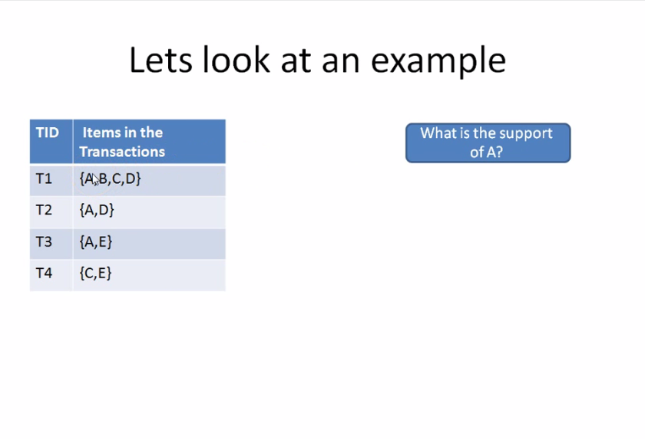
Frequent items

Slide 11
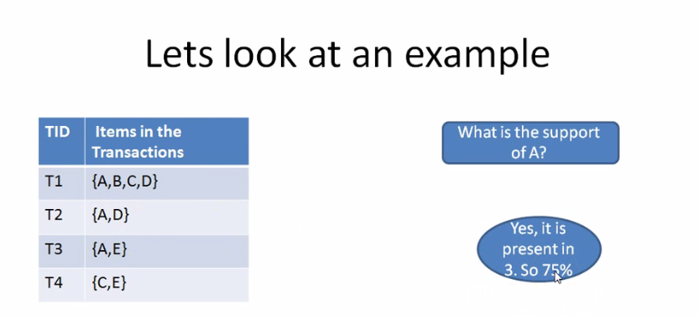
Frequent items

Slide 12
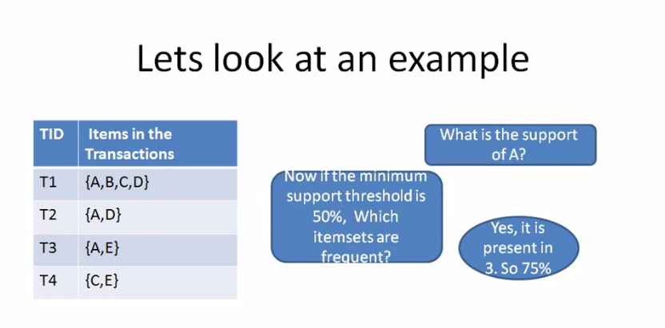
Frequent items

Slide 13
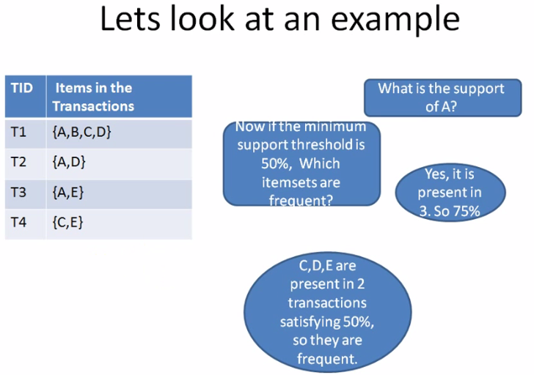
Frequent items

Slide 14
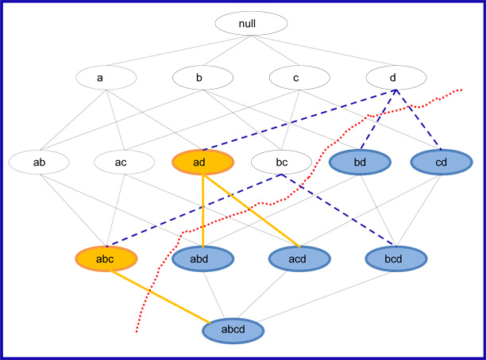
Frequent items
See document: Maximum Frequent Itemset.docx

Slide 15
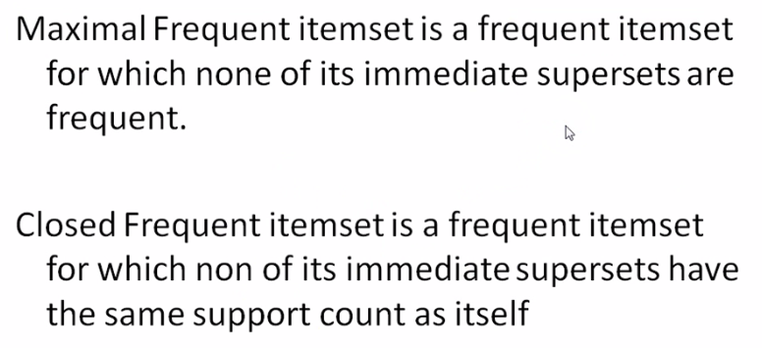
Max Frequent and Closed Frequent Itemsets
See video
Maximal frequent itemsets.mp4

Slide 16
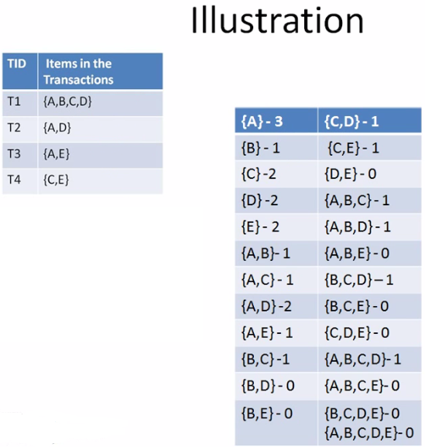
Max Frequent and Closed Frequent Itemsets

Slide 17
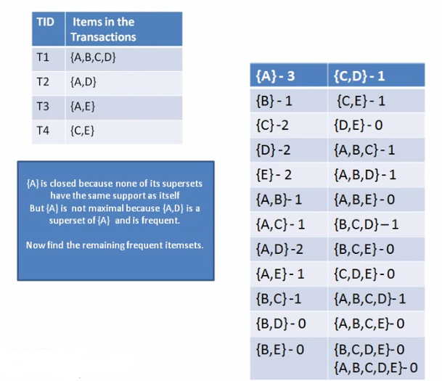
Max Frequent and Closed Frequent Itemsets

Slide 18
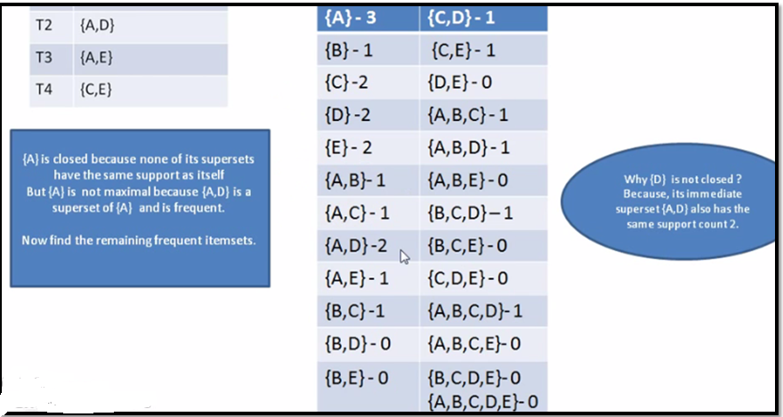
Max Frequent and Closed Frequent Itemsets

Slide 19
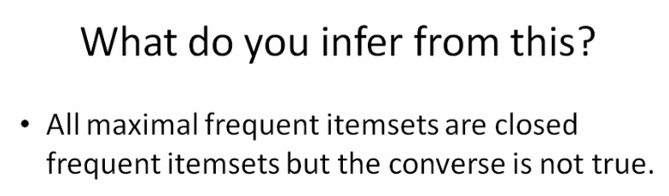
Max Frequent and Closed Frequent Itemsets
Freq itemset
Closed Freq itemset
Max Freq Itemset

Slide 20
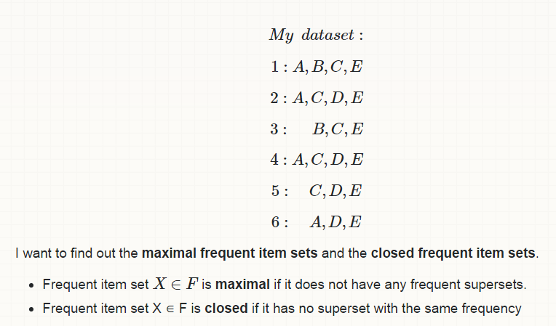
Max Frequent and Closed Frequent Itemsets

Slide 21
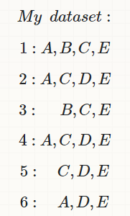
Find frequent itemsets for 1,2,3

Slide 22
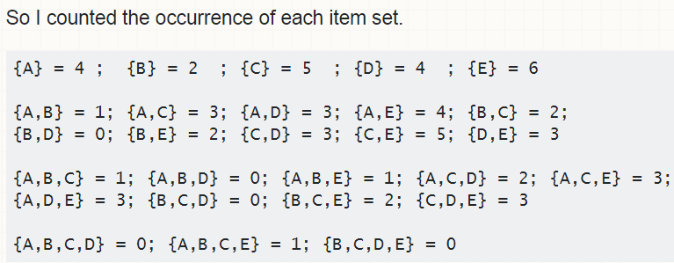
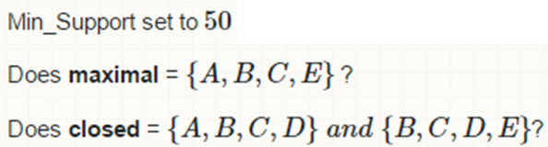

Slide 23
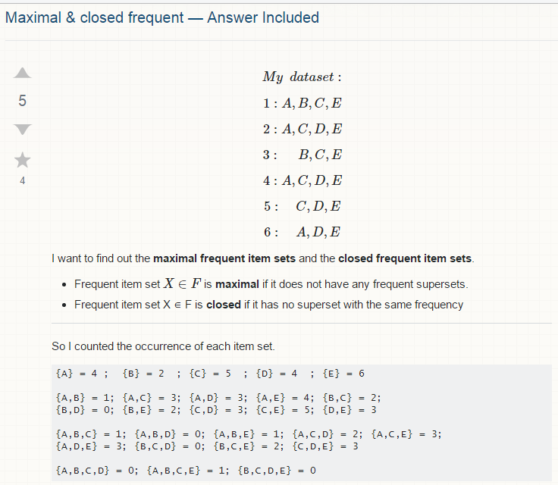

Slide 24
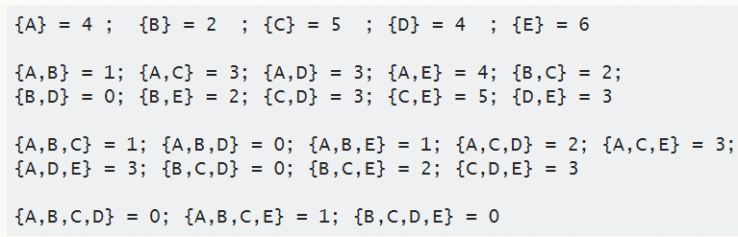
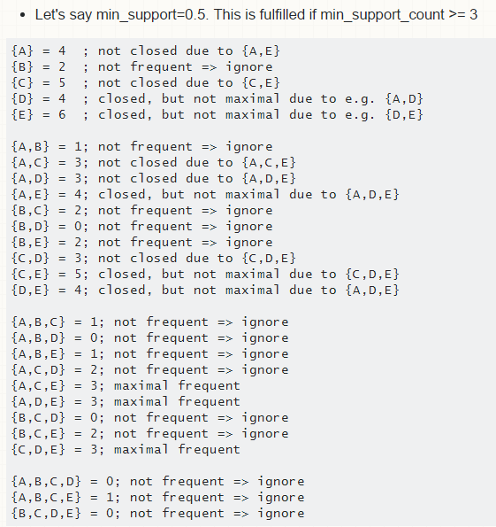

Slide 25
T₁={bread,diapers,milk}
T₂={diaper,bread,soda}
T₃={diaper,meat,beer}
.
.
.
T_{n}
T₁…T_{n} tuples, here each consist of 3 itemsets
Tuples may be of different size (itemsets)
T₁C[n], each tuple T1 is subset of domain n

Slide 26
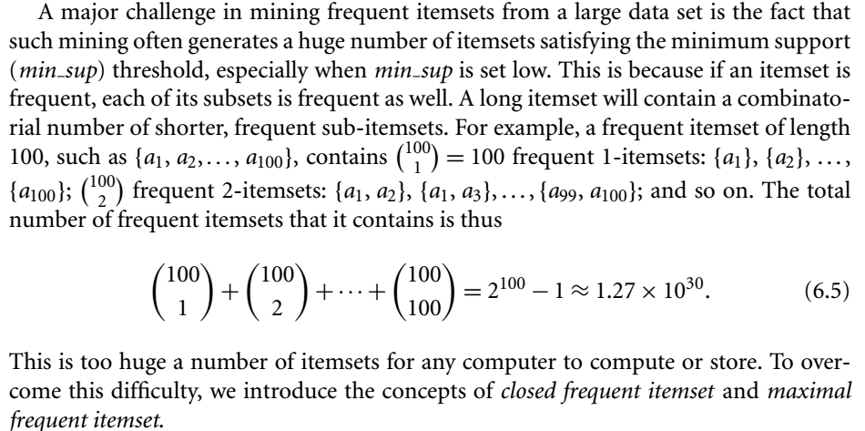

Slide 27
Closed Patterns and Max-Patterns
A long pattern contains a combinatorial number of sub-patterns, e.g., {a₁, …, a₁₀₀} contains (₁₀₀¹) + (₁₀₀²) + … + (₁¹₀⁰₀⁰) = 2¹⁰⁰ – 1 = 1.27*10³⁰ sub-patterns!
Solution: Mine closed patterns and max-patterns instead
An itemset X is closed if X is frequent and there exists no super-pattern Y כ X, with the same support as X (proposed by Pasquier, et al. @ ICDT’99)
An itemset X is a max-pattern if X is frequent and there exists no frequent super-pattern Y כ X (proposed by Bayardo @ SIGMOD’98)
Closed pattern is a lossless compression of freq. patterns
Reducing the # of patterns and rules

Slide 28
Closed Patterns and Max-Patterns
Exercise. DB = {<a₁, …, a₁₀₀>, < a₁, …, a₅₀>}
Min_sup = 1.
What is the set of closed itemset?
<a₁, …, a₁₀₀>: 1
< a₁, …, a₅₀>: 2
What is the set of max-pattern?
<a₁, …, a₁₀₀>: 1
What is the set of all patterns?
!!

Slide 29
Computational Complexity of Frequent Itemset Mining
How many itemsets are potentially to be generated in the worst case?
The number of frequent itemsets to be generated is senstive to the minsup threshold
When minsup is low, there exist potentially an exponential number of frequent itemsets
The worst case: M^{N} where M: # distinct items, and N: max length of transactions
The worst case complexty vs. the expected probability
Ex. Suppose Walmart has 10⁴ kinds of products
The chance to pick up one product 10⁻⁴
The chance to pick up a particular set of 10 products: ~10⁻⁴⁰
What is the chance this particular set of 10 products to be frequent 10³ times in 10⁹ transactions?

Slide 30
Chapter 5: Mining Frequent Patterns, Association and Correlations: Basic Concepts and Methods
Basic Concepts
Frequent Itemset Mining Methods
Which Patterns Are Interesting?—Pattern Evaluation Methods
Summary

Slide 31
Scalable Frequent Itemset Mining Methods
Apriori: A Candidate Generation-and-Test Approach
Improving the Efficiency of Apriori
FPGrowth: A Frequent Pattern-Growth Approach
ECLAT: Frequent Pattern Mining with Vertical Data Format

Slide 32
The Downward Closure Property and Scalable Mining Methods
The downward closure property of frequent patterns
Any subset of a frequent itemset must be frequent
If {beer, diaper, nuts} is frequent, so is {beer, diaper}
i.e., every transaction having {beer, diaper, nuts} also contains {beer, diaper}
Scalable mining methods: Three major approaches
Apriori (Agrawal & Srikant@VLDB’94)
Freq. pattern growth (FPgrowth—Han, Pei & Yin @SIGMOD’00)
Vertical data format approach (Charm—Zaki & Hsiao @SDM’02)

Slide 33
Apriori: A Candidate Generation & Test Approach
Apriori pruning principle: If there is any itemset which is infrequent, its superset should not be generated/tested! (Agrawal & Srikant @VLDB’94, Mannila, et al. @ KDD’ 94)
Method:
Initially, scan DB once to get frequent 1-itemset
Generate length (k+1) candidate itemsets from length k frequent itemsets
Test the candidates against DB
Terminate when no frequent or candidate set can be generated

Slide 34
The Apriori Algorithm—An Example
Sup_{min} = 2
Itemset | sup
{A} | 2
{B} | 3
{C} | 3
{D} | 1
{E} | 3
Database TDB
Itemset | sup
{A} | 2
{B} | 3
{C} | 3
{E} | 3
L₁
Tid | Items
10 | A, C, D
20 | B, C, E
30 | A, B, C, E
40 | B, E
C₁
1st scan
C₂
Itemset | sup
{A, B} | 1
{A, C} | 2
{A, E} | 1
{B, C} | 2
{B, E} | 3
{C, E} | 2
C₂
Itemset
{A, B}
{A, C}
{A, E}
{B, C}
{B, E}
{C, E}
L₂
Itemset | sup
{A, C} | 2
{B, C} | 2
{B, E} | 3
{C, E} | 2
2nd scan
Pruning see next slide
C₃
Itemset
{B, C, E}
3rd scan
L₃
Itemset | sup
{B, C, E} | 2
Notes:
Pruning

Slide 35
Pruning
Apriori property: All nonempty subsets of a frequent itemset must also be frequent . (Downward closure property)
It uses the Apriori property to eliminate those having a subset that is not frequent (step 3).
C₂
Itemset | sup
{A, B} | 1
{A, C} | 2
{A, E} | 1
{B, C} | 2
{B, E} | 3
{C, E} | 2
C3 | Subsets |  |  | Is Frequent
ABC | AB | AC | BC | NO
ABE | AB | AE | BE | NO
ACE | AC | AE | CE | NO
BCE | BC | BE | CE | YES
C₃
Itemset
{B, C, E}

Slide 36
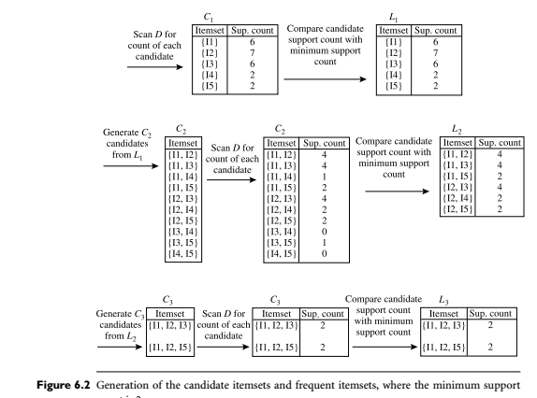
Example 2

Slide 37
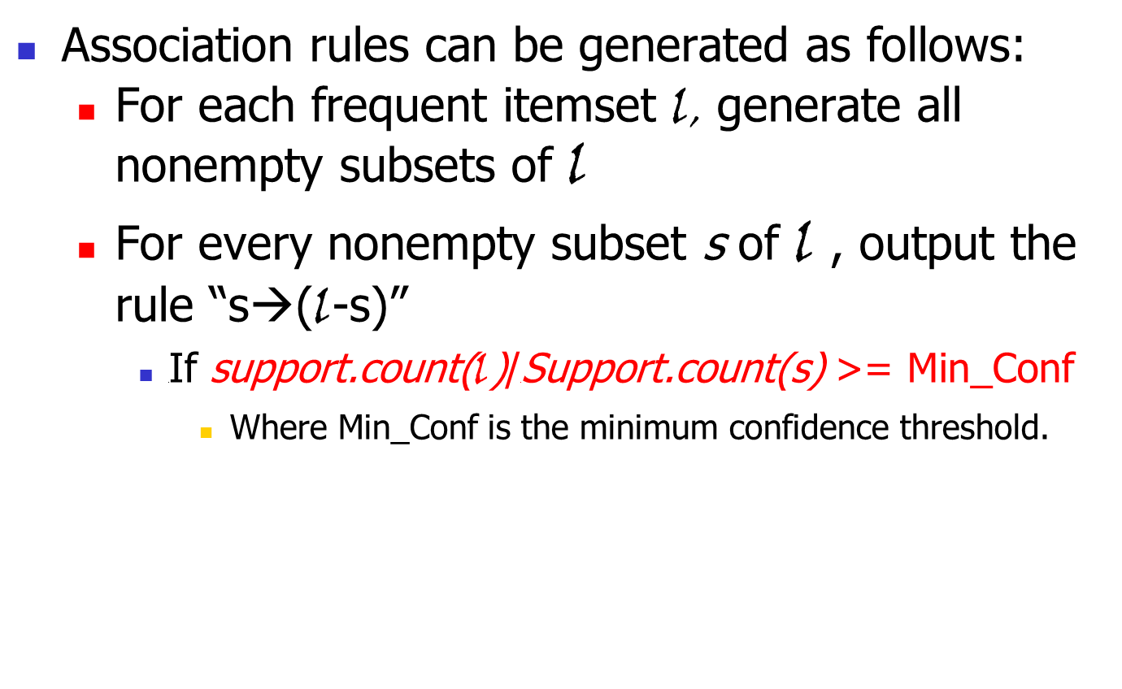
Association rule generation
Association rules can be generated as follows:
For each frequent itemset l, generate all nonempty subsets of l
For every nonempty subset s of l , output the rule “s→(l-s)”
If support.count(l)/Support.count(s) >= Min_Conf
Where Min_Conf is the minimum confidence threshold.

Slide 38
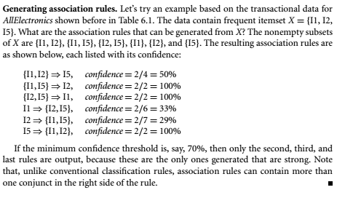
Association rule generation

Slide 39
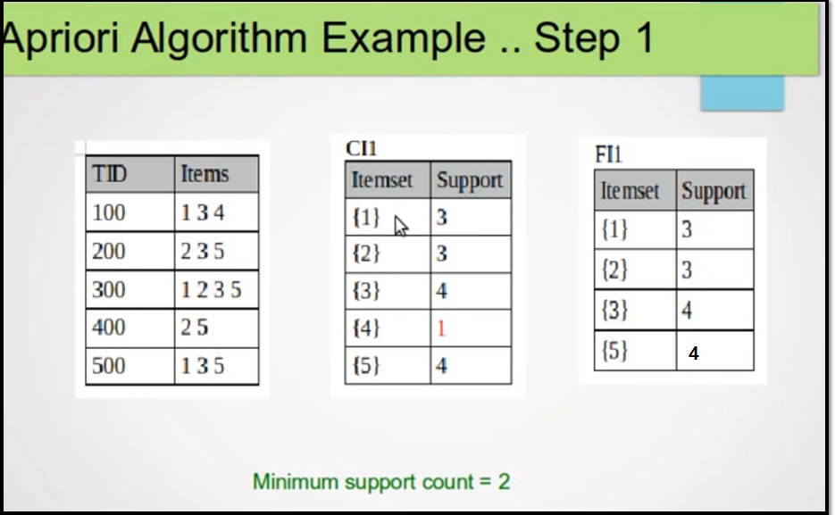
Example 3

Slide 40
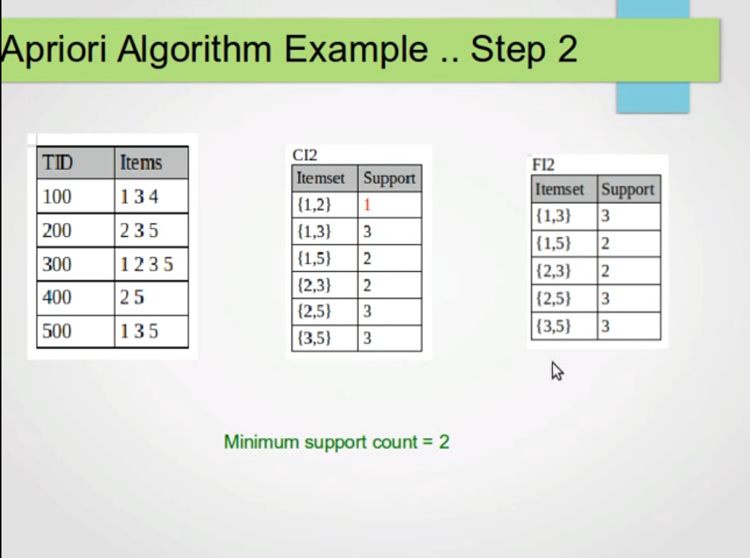
Example 3

Slide 41
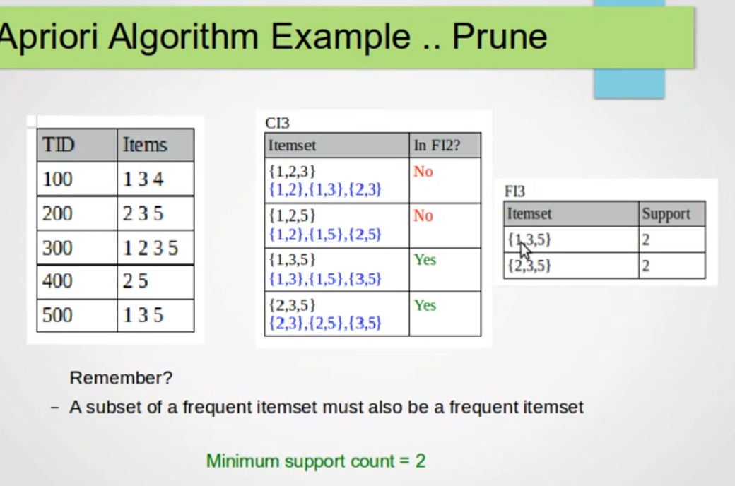
Example 3

Slide 42
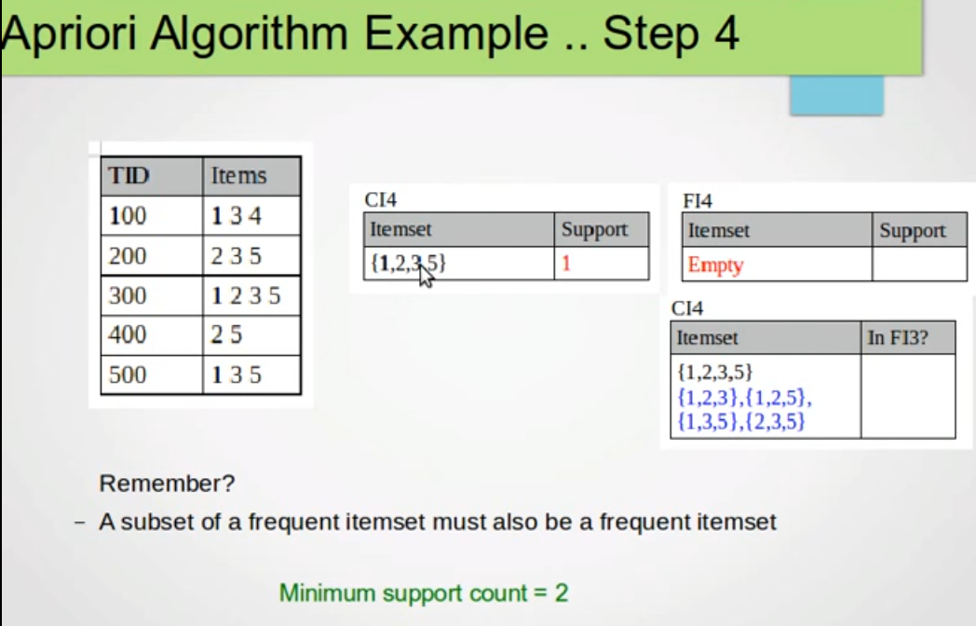
Example 3

Slide 43
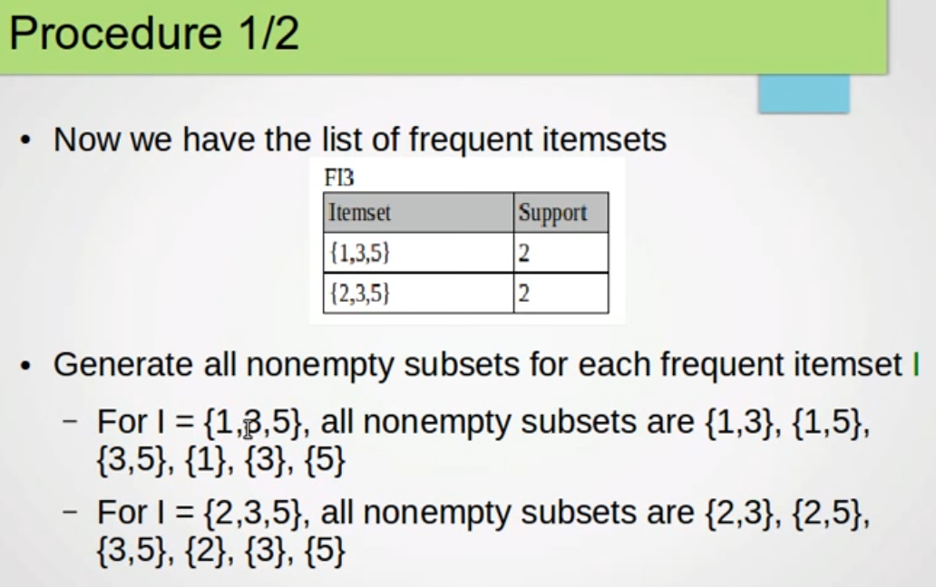
How to make association rules

Slide 44
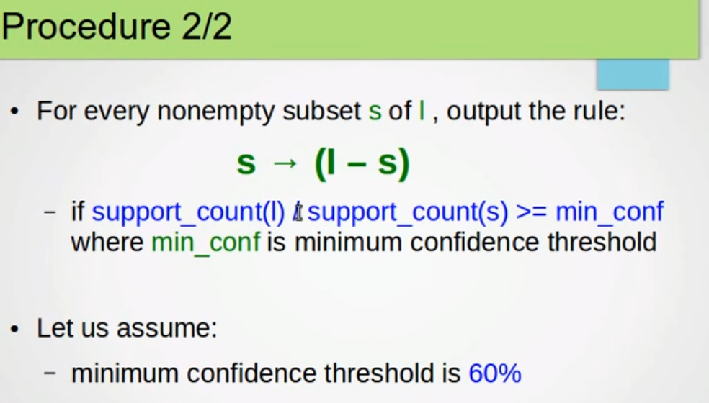
How to make association rules

Slide 45
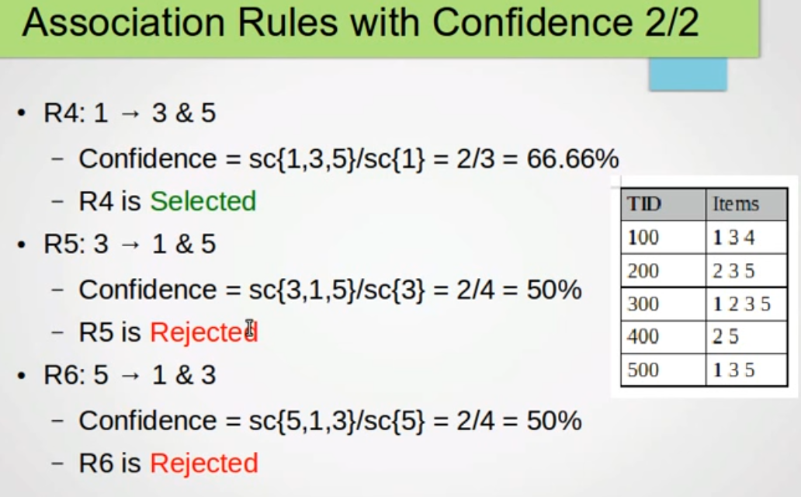
How to make association rules

Slide 46
The Apriori Algorithm (Pseudo-Code)
C_{k}: Candidate itemset of size k
L_{k} : frequent itemset of size k
L₁ = {frequent items};
for (k = 1; L_{k} !=∅; k++) do begin
C_{k+1} = candidates generated from L_{k};
for each transaction t in database do
increment the count of all candidates in C_{k+1} that are contained in t
L_{k+1} = candidates in C_{k+1} with min_support
end
return ∪_{k} L_{k};

Slide 47
Implementation of Apriori
How to generate candidates?
Step 1: self-joining L_{k}
Step 2: pruning
Example of Candidate-generation
L₃={abc, abd, acd, ace, bcd}
Self-joining: L₃*L₃
abcd from abc and abd
acde from acd and ace
Pruning:
acde is removed because ade is not in L₃
C₄ = {abcd}

Slide 48
Summary of Apriori
Boolean association rules state associations between the presence of certain items with the presence of some other items
Association rules are measured and evaluated in terms of support, confidence and lift.
The most significant part of association rule mining is the discovery of frequent itemsets
Apriori algorithm for finding frequent itemsets follows a create-and-test greedy approach. FP-growth algorithm offers an alternative by traversing a FP-tree without generating candidate itemsets
Apriori approach is also used for generating rule expressions
Generalised rules represent associations between data concepts (categories)
Quantitative rules describe associations among values of different attributes
Apriori approach has been adapted for mining the various associations.
In the context of generalised and quantitative rules, there exist redundant rules that need to be pruned
Association rule mining faces with practical problems and issues

Slide 49
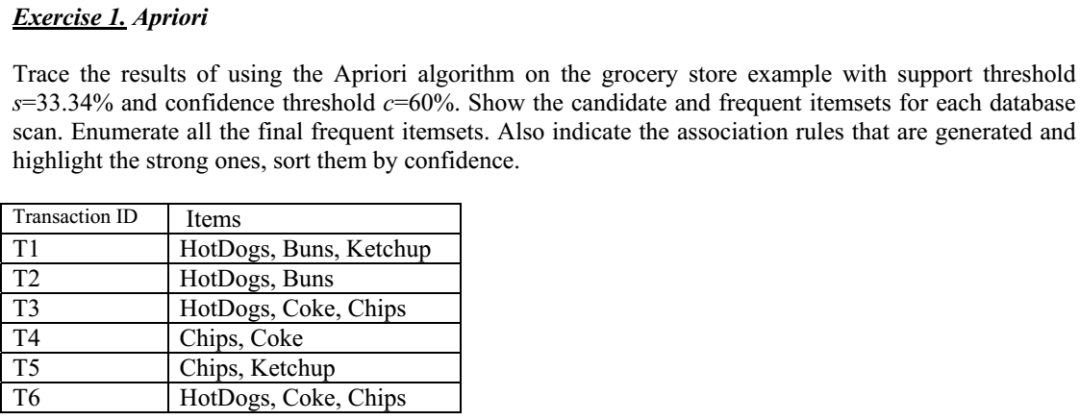
H.W

Slide 50
Candidate Generation: An SQL Implementation
SQL Implementation of candidate generation
Suppose the items in L_{k-1} are listed in an order
Step 1: self-joining L_{k-1}
insert into C_{k}
select p.item₁, p.item₂, …, p.item_{k-1}, q.item_{k-1}
from L_{k-1} p, L_{k-1} q
where p.item₁=q.item₁, …, p.item_{k-2}=q.item_{k-2}, p.item_{k-1} < q.item_{k-1}
Step 2: pruning
forall itemsets c in C_{k} do
forall (k-1)-subsets s of c do
if (s is not in L_{k-1}) then delete c from C_{k}
Use object-relational extensions like UDFs, BLOBs, and Table functions for efficient implementation [See: S. Sarawagi, S. Thomas, and R. Agrawal. Integrating association rule mining with relational database systems: Alternatives and implications. SIGMOD’98]

Slide 51
Scalable Frequent Itemset Mining Methods
51
Apriori: A Candidate Generation-and-Test Approach
Improving the Efficiency of Apriori
FPGrowth: A Frequent Pattern-Growth Approach
ECLAT: Frequent Pattern Mining with Vertical Data Format
Mining Close Frequent Patterns and Maxpatterns
Notes:
51

Slide 52
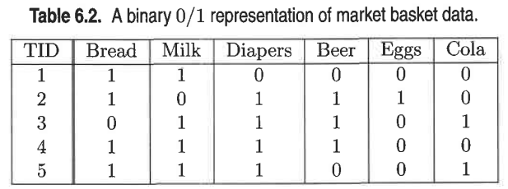
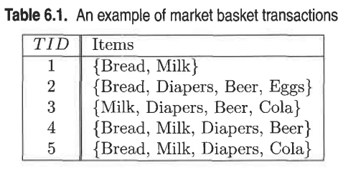
Use RapidMiner to generate FPs and Association Rules
Asymmetric binary representation of market basket data

Slide 53
H.W (RapidMiner)
Outlook | Temperature | Humidity | Windy | Play
Sunny | Hot | High | False | No
Sunny | Hot | High | True | No
Overcast | Hot | High | False | Yes
Rainy | Mild | High | False | Yes
Rainy | Cool | Normal | False | Yes
Rainy | Cool | Normal | True | No
Overcast | Cool | Normal | True | Yes
Sunny | Mild | High | False | No
Sunny | Cool | Normal | False | Yes
Rainy | Mild | Normal | False | Yes
Sunny | Mild | Normal | True | Yes
Overcast | Mild | High | True | Yes
Overcast | Hot | Normal | False | Yes
Rainy | Mild | High | True | No

Slide 54
Further Improvement of the Apriori Method
Major computational challenges
Multiple scans of transaction database
Huge number of candidates
Tedious workload of support counting for candidates
Improving Apriori: general ideas
Reduce passes of transaction database scans
Shrink number of candidates
Facilitate support counting of candidates

Slide 55
How to Count Supports of Candidates?
Why counting supports of candidates a problem?
The total number of candidates can be very huge
One transaction may contain many candidates (Number of transaction, items in each transaction, itemset size)

Slide 56
How to Count Supports of Candidates?
Why counting supports of candidates a problem?
The total number of candidates can be very huge
One transaction may contain many candidates (Number of transaction, items in each transaction, itemset size)
Method:
Candidate itemsets are stored in a hash-tree
Leaf node of hash-tree contains a list of itemsets and counts
Interior node contains a hash table
Subset function: finds all the candidates contained in a transaction

Slide 57
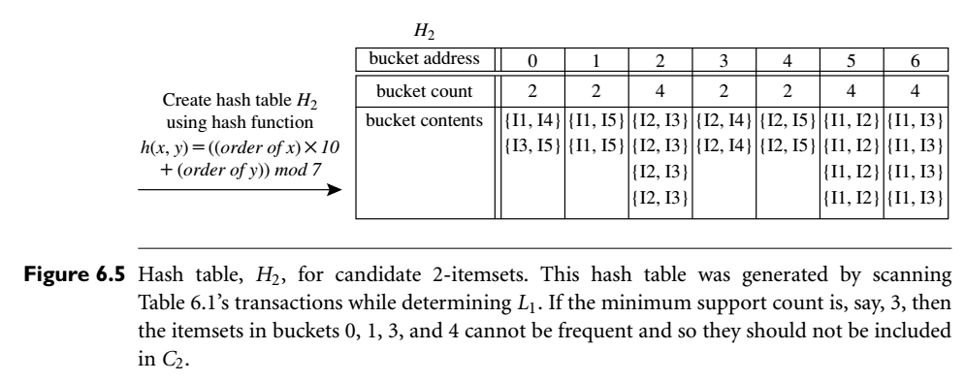
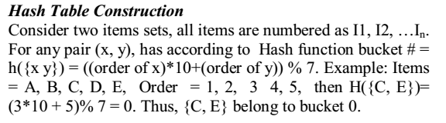
Hash table

Slide 58
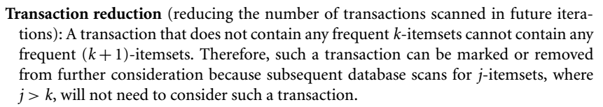
Transaction reduction

Slide 59
Counting Supports of Candidates Using Hash Tree
h(p)=p mod 3, like 1,4,7 are hashed in left bucket due to same remainder i.e 1.
All candidate itemsets are stored at the leaf nodes of the hash tree
Subset function
Transaction: 1 2 3 5 6
3,6,9
1,4,7
2,5,8
1 + 2 3 5 6
1 3 + 5 6
2 3 4
5 6 7
1 4 5
3 4 5
3 5 6
3 5 7
6 8 9
3 6 7
3 6 8
1 3 6
1 2 + 3 5 6
1 2 4
4 5 7
1 2 5
4 5 8
1 5 9
Notes:
h(p)=p mod 3, like 1,4,7 are hashed in left bucket due to same remainder i.e 1.

Slide 60
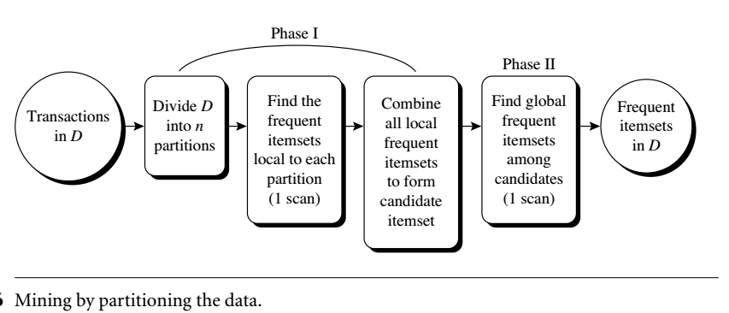
Mining by partitioning the data

Slide 61
Partition: Scan Database Only Twice
Any itemset that is potentially frequent in DB must be frequent in at least one of the partitions of DB
Scan 1: partition database and find local frequent patterns
Scan 2: consolidate global frequent patterns
A. Savasere, E. Omiecinski and S. Navathe, VLDB’95
DB₁
+
DB₂
+
+
DB_{k}
= DB
sup₁(i) < σDB₁
sup₂(i) < σDB₂
sup_{k}(i) < σDB_{k}
sup(i) < σDB

Slide 62
Sampling
Mining on a subset of the given data:
The basic idea of the sampling approach is to pick a random sample S of the given data D, and then search for frequent itemsets in S instead of D.
In this way, we trade off some degree of accuracy against efficiency.
The S sample size is such that the search for frequent itemsets in S can be done in main memory, and so only one scan of the transactions in S is required overall.
Because we are searching for frequent itemsets in S rather than in D, it is possible that we will miss some of the global frequent itemsets.

Slide 63
Sampling for Frequent Patterns
Select a sample of original database, mine frequent patterns within sample using Apriori
Scan database once to verify frequent itemsets found in sample, only borders of closure of frequent patterns are checked
Example: check abcd instead of ab, ac, …, etc.
Scan database again to find missed frequent patterns
H. Toivonen. Sampling large databases for association rules. In VLDB’96

Slide 64
Dynamic itemset counting (DIC)
adding candidate itemsets at different points during a scan:
A dynamic itemset counting technique was proposed in which the database is partitioned into blocks marked by start points.
If the count-so-far passes the minimum support, the itemset is added into the frequent itemset collection and can be used to generate longer candidates.
This leads to fewer database scans than with Apriori for finding all the frequent itemsets.

Slide 65
DIC: Reduce Number of Scans
ABCD
Once both A and D are determined frequent, the counting of AD begins
Once all length-2 subsets of BCD are determined frequent, the counting of BCD begins
ABC
ABD
ACD
BCD
AB
AC
BC
AD
BD
CD
Transactions
1-itemsets
A
B
C
D
Apriori
2-itemsets
…
{}
Itemset lattice
1-itemsets
2-items
S. Brin R. Motwani, J. Ullman, and S. Tsur. Dynamic itemset counting and implication rules for market basket data. SIGMOD’97
DIC
3-items

Slide 66
DHP: Reduce the Number of Candidates
A k-itemset whose corresponding hashing bucket count is below the threshold cannot be frequent
Candidates: a, b, c, d, e
Hash entries
{ab, ad, ae}
{bd, be, de}
…
Frequent 1-itemset: a, b, d, e
ab is not a candidate 2-itemset if the sum of count of {ab, ad, ae} is below support threshold
J. Park, M. Chen, and P. Yu. An effective hash-based algorithm for mining association rules. SIGMOD’95
count
itemsets
35
{ab, ad, ae}
88
{bd, be, de}
...
...
102
{yz, qs, wt}
Hash Table
Notes:
Direct Hashing and pruning (DHP)

Slide 67
Scalable Frequent Itemset Mining Methods
67
Apriori: A Candidate Generation-and-Test Approach
Improving the Efficiency of Apriori
FPGrowth: A Frequent Pattern-Growth Approach
ECLAT: Frequent Pattern Mining with Vertical Data Format
Mining Close Frequent Patterns and Maxpatterns
Notes:
67

Slide 68
Pattern-Growth Approach: Mining Frequent Patterns Without Candidate Generation
Bottlenecks of the Apriori approach
Breadth-first (i.e., level-wise) search
Candidate generation and test
Often generates a huge number of candidates
The FPGrowth Approach (J. Han, J. Pei, and Y. Yin, SIGMOD’ 00)
Depth-first search
Avoid explicit candidate generation
Major philosophy: Grow long patterns from short ones using local frequent items only
“abc” is a frequent pattern
Get all transactions having “abc”, i.e., project DB on abc: DB|abc
“d” is a local frequent item in DB|abc → abcd is a frequent pattern

Slide 69
Construct FP-tree from a Transaction Database
TID Items bought (ordered) frequent items
100 {f, a, c, d, g, i, m, p} {f, c, a, m, p}
200 {a, b, c, f, l, m, o} {f, c, a, b, m}
300 {b, f, h, j, o, w} {f, b}
400 {b, c, k, s, p} {c, b, p}
500 {a, f, c, e, l, p, m, n} {f, c, a, m, p}
min_support = 3
{}
Header Table
Item frequency head
f 4
c 4
a 3
b 3
m 3
p 3
Scan DB once, find frequent 1-itemset (single item pattern)
Sort frequent items in frequency descending order, f-list
Scan DB again, construct FP-tree
f:4
c:1
c:3
b:1
b:1
a:3
p:1
m:2
b:1
F-list = f-c-a-b-m-p
p:2
m:1

Slide 70
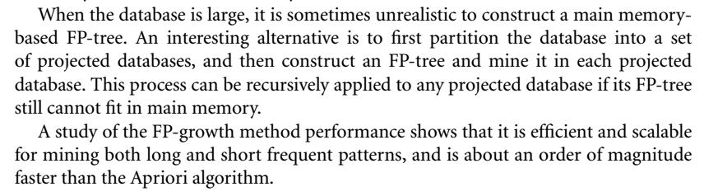

Slide 71
Partition Patterns and Databases
Frequent patterns can be partitioned into subsets according to f-list
F-list = f-c-a-b-m-p
Patterns containing p
Patterns having m but no p
…
Patterns having c but no a nor b, m, p
Pattern f
Completeness and non-redundency

Slide 72
Find Patterns Having P From P-conditional Database
Starting at the frequent item header table in the FP-tree
Traverse the FP-tree by following the link of each frequent item p
Accumulate all of transformed prefix paths of item p to form p’s conditional pattern base
{}
Header Table
Item frequency head
f 4
c 4
a 3
b 3
m 3
p 3
f:4
c:1
Conditional pattern bases
item cond. pattern base
c f:3
a fc:3
b fca:1, f:1, c:1
m fca:2, fcab:1
p fcam:2, cb:1
c:3
b:1
b:1
a:3
p:1
m:2
b:1
p:2
m:1

Slide 73
From Conditional Pattern-bases to Conditional FP-trees
For each pattern-base
Accumulate the count for each item in the base
Construct the FP-tree for the frequent items of the pattern base
m-conditional pattern base:
fca:2, fcab:1
{}
Header Table
Item frequency head
f 4
c 4
a 3
b 3
m 3
p 3
f:4
c:1
All frequent patterns relate to m
m,
fm, cm, am,
fcm, fam, cam,
fcam
{}
c:3
b:1
b:1

f:3

a:3
p:1
m:2
b:1
c:3
p:2
m:1
a:3
m-conditional FP-tree

Slide 74
Recursion: Mining Each Conditional FP-tree
{}
{}
Cond. pattern base of “am”: (fc:3)
f:3
c:3
f:3
am-conditional FP-tree
c:3
{}
Cond. pattern base of “cm”: (f:3)
a:3
f:3
m-conditional FP-tree
cm-conditional FP-tree
{}
Cond. pattern base of “cam”: (f:3)
f:3
cam-conditional FP-tree

Slide 75
A Special Case: Single Prefix Path in FP-tree
Suppose a (conditional) FP-tree T has a shared single prefix-path P
Mining can be decomposed into two parts
Reduction of the single prefix path into one node
Concatenation of the mining results of the two parts
{}
a₁:n₁
a₂:n₂
a₃:n₃
{}
r₁
b₁:m₁
C₁:k₁
a₁:n₁
+

r₁
=
b₁:m₁
C₁:k₁
a₂:n₂
C₂:k₂
C₃:k₃
a₃:n₃
C₂:k₂
C₃:k₃

Slide 76
Benefits of the FP-tree Structure
Completeness
Preserve complete information for frequent pattern mining
Never break a long pattern of any transaction
Compactness
Reduce irrelevant info—infrequent items are gone
Items in frequency descending order: the more frequently occurring, the more likely to be shared
Never be larger than the original database (not count node-links and the count field)

Slide 77
The Frequent Pattern Growth Mining Method
Idea: Frequent pattern growth
Recursively grow frequent patterns by pattern and database partition
Method
For each frequent item, construct its conditional pattern-base, and then its conditional FP-tree
Repeat the process on each newly created conditional FP-tree
Until the resulting FP-tree is empty, or it contains only one path—single path will generate all the combinations of its sub-paths, each of which is a frequent pattern

Slide 78
Scaling FP-growth by Database Projection
What about if FP-tree cannot fit in memory?
DB projection
First partition a database into a set of projected DBs
Then construct and mine FP-tree for each projected DB
Parallel projection vs. partition projection techniques
Parallel projection
Project the DB in parallel for each frequent item
Parallel projection is space costly
All the partitions can be processed in parallel
Partition projection
Partition the DB based on the ordered frequent items
Passing the unprocessed parts to the subsequent partitions

Slide 79
Partition-Based Projection
Parallel projection needs a lot of disk space
Partition projection saves it
Tran. DB
fcamp
fcabm
fb
cbp
fcamp
p-proj DB
fcam
cb
fcam
m-proj DB
fcab
fca
fca
b-proj DB
f
cb
…
a-proj DB
fc
…
c-proj DB
f
…
f-proj DB
…
am-proj DB
fc
fc
fc
cm-proj DB
f
f
f
…

Slide 80
Performance of FPGrowth in Large Datasets
Data set T25I20D10K
Data set T25I20D100K
FP-Growth vs. Apriori
FP-Growth vs. Tree-Projection

Slide 81
Advantages of the Pattern Growth Approach
Divide-and-conquer:
Decompose both the mining task and DB according to the frequent patterns obtained so far
Lead to focused search of smaller databases
Other factors
No candidate generation, no candidate test
Compressed database: FP-tree structure
No repeated scan of entire database
Basic ops: counting local freq items and building sub FP-tree, no pattern search and matching
A good open-source implementation and refinement of FPGrowth
FPGrowth+ (Grahne and J. Zhu, FIMI'03)

Slide 82
Further Improvements of Mining Methods
AFOPT (Liu, et al. @ KDD’03)
A “push-right” method for mining condensed frequent pattern (CFP) tree
Carpenter (Pan, et al. @ KDD’03)
Mine data sets with small rows but numerous columns
Construct a row-enumeration tree for efficient mining
FPgrowth+ (Grahne and Zhu, FIMI’03)
Efficiently Using Prefix-Trees in Mining Frequent Itemsets, Proc. ICDM'03 Int. Workshop on Frequent Itemset Mining Implementations (FIMI'03), Melbourne, FL, Nov. 2003
TD-Close (Liu, et al, SDM’06)

Slide 83
Extension of Pattern Growth Mining Methodology
Mining closed frequent itemsets and max-patterns
CLOSET (DMKD’00), FPclose, and FPMax (Grahne & Zhu, Fimi’03)
Mining sequential patterns
PrefixSpan (ICDE’01), CloSpan (SDM’03), BIDE (ICDE’04)
Mining graph patterns
gSpan (ICDM’02), CloseGraph (KDD’03)
Constraint-based mining of frequent patterns
Convertible constraints (ICDE’01), gPrune (PAKDD’03)
Computing iceberg data cubes with complex measures
H-tree, H-cubing, and Star-cubing (SIGMOD’01, VLDB’03)
Pattern-growth-based Clustering
MaPle (Pei, et al., ICDM’03)
Pattern-Growth-Based Classification
Mining frequent and discriminative patterns (Cheng, et al, ICDE’07)

Slide 84
Scalable Frequent Itemset Mining Methods
Apriori: A Candidate Generation-and-Test Approach
Improving the Efficiency of Apriori
FPGrowth: A Frequent Pattern-Growth Approach
EClaT: Frequent Pattern Mining with Vertical Data Format
Mining Close Frequent Patterns and Maxpatterns
Notes:
Equivalence CLASS Transformation (ECLAT)

Slide 85
ECLAT: Mining by Exploring Vertical Data Format
Vertical format: t(AB) = {T₁₁, T₂₅, …}
tid-list: list of trans.-ids containing an itemset
Deriving frequent patterns based on vertical intersections
t(X) = t(Y): X and Y always happen together
t(X) ⊂ t(Y): transaction having X always has Y
Using diffset to accelerate mining
Only keep track of differences of tids
t(X) = {T₁, T₂, T₃}, t(XY) = {T₁, T₃}
Diffset (XY, X) = {T₂}
Eclat (Zaki et al. @KDD’97)
Mining Closed patterns using vertical format: CHARM (Zaki & Hsiao@SDM’02)
Notes:
Equivalence CLASS Transformation (ECLAT)

Slide 86
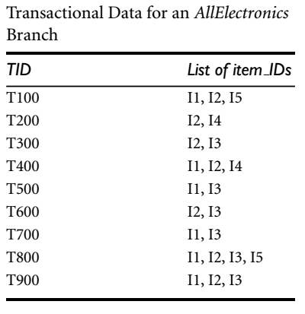
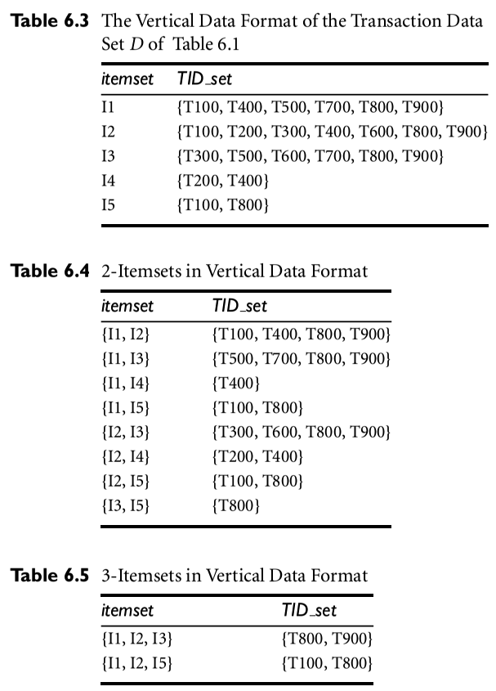

Slide 87
Scalable Frequent Itemset Mining Methods
87
Apriori: A Candidate Generation-and-Test Approach
Improving the Efficiency of Apriori
FPGrowth: A Frequent Pattern-Growth Approach
ECLAT: Frequent Pattern Mining with Vertical Data Format
Mining Close Frequent Patterns and Maxpatterns
Notes:
87

Slide 88
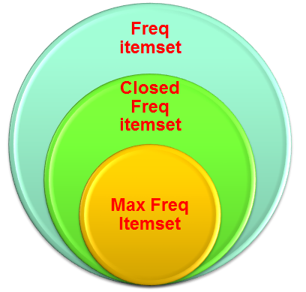
Max. and Closed Freq. Itemset
Maximum Frequent Itemset:
None of its proper superset is frequent
Closed Frequent Itemset:
None of its proper superset posses same support count. (e.g Sup_count=2)
Subset sup_count >= Proper super-set Supp_Count
Itemset | Proper Superset | MAX. | CLOSED
A=3 | AB=2 | N | Y
A=2 | AB=1 | Y | Y
A=2 | AB=2 | N | N

Slide 89
Mining Frequent Closed Patterns: CLOSET
Flist: list of all frequent items in support ascending order
Flist: d-a-f-e-c
Divide search space
Patterns having d
Patterns having d but no a, etc.
Find frequent closed pattern recursively
Every transaction having d also has cfa → cfad is a frequent closed pattern
J. Pei, J. Han & R. Mao. “CLOSET: An Efficient Algorithm for Mining Frequent Closed Itemsets", DMKD'00.
Min_sup=2
TID | Items
10 | a, c, d, e, f
20 | a, b, e
30 | c, e, f
40 | a, c, d, f
50 | c, e, f

Slide 90
CLOSET+: Mining Closed Itemsets by Pattern-Growth
Itemset merging: if Y appears in every occurrence of X, then Y is merged with X
Sub-itemset pruning: if Y כ X, and sup(X) = sup(Y), X and all of X’s descendants in the set enumeration tree can be pruned
Hybrid tree projection
Bottom-up physical tree-projection
Top-down pseudo tree-projection
Item skipping: if a local frequent item has the same support in several header tables at different levels, one can prune it from the header table at higher levels
Efficient subset checking

Slide 91
MaxMiner: Mining Max-Patterns
1st scan: find frequent items
A, B, C, D, E
2nd scan: find support for
AB, AC, AD, AE, ABCDE
BC, BD, BE, BCDE
CD, CE, CDE, DE
Since BCDE is a max-pattern, no need to check BCD, BDE, CDE in later scan
R. Bayardo. Efficiently mining long patterns from databases. SIGMOD’98
Tid | Items
10 | A, B, C, D, E
20 | B, C, D, E,
30 | A, C, D, F
Potential max-patterns

Slide 92
CHARM: Mining by Exploring Vertical Data Format
Vertical format: t(AB) = {T₁₁, T₂₅, …}
tid-list: list of trans.-ids containing an itemset
Deriving closed patterns based on vertical intersections
t(X) = t(Y): X and Y always happen together
t(X) ⊂ t(Y): transaction having X always has Y
Using diffset to accelerate mining
Only keep track of differences of tids
t(X) = {T₁, T₂, T₃}, t(XY) = {T₁, T₃}
Diffset (XY, X) = {T₂}
Eclat/MaxEclat (Zaki et al. @KDD’97), VIPER(P. Shenoy et al.@SIGMOD’00), CHARM (Zaki & Hsiao@SDM’02)

Slide 93
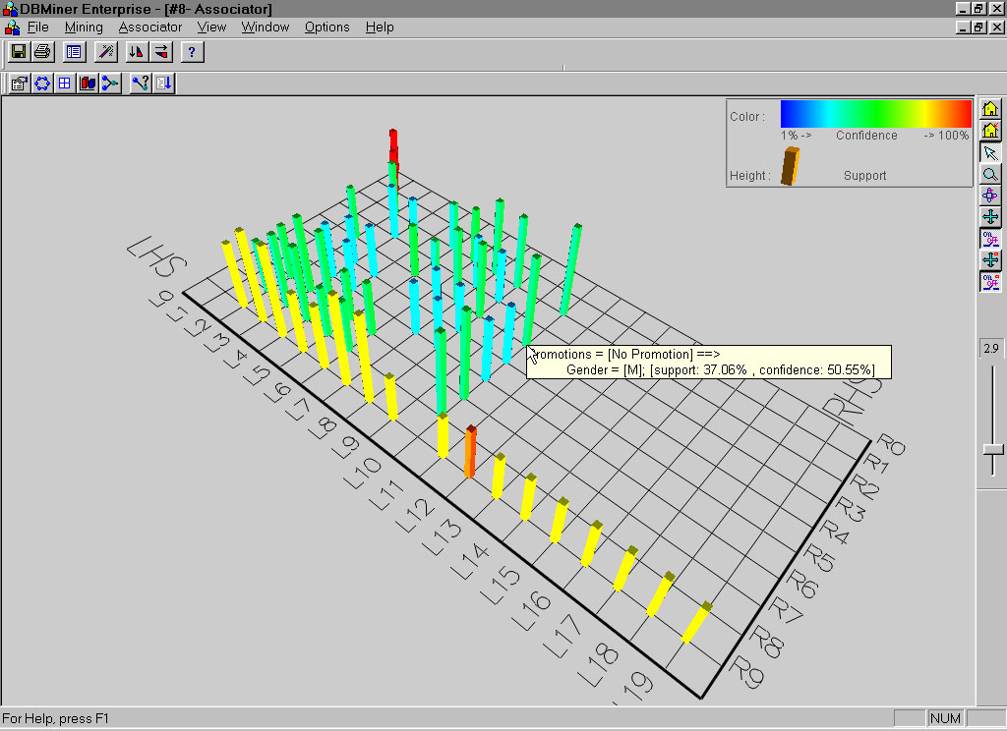
Visualization of Association Rules: Plane Graph

Slide 94
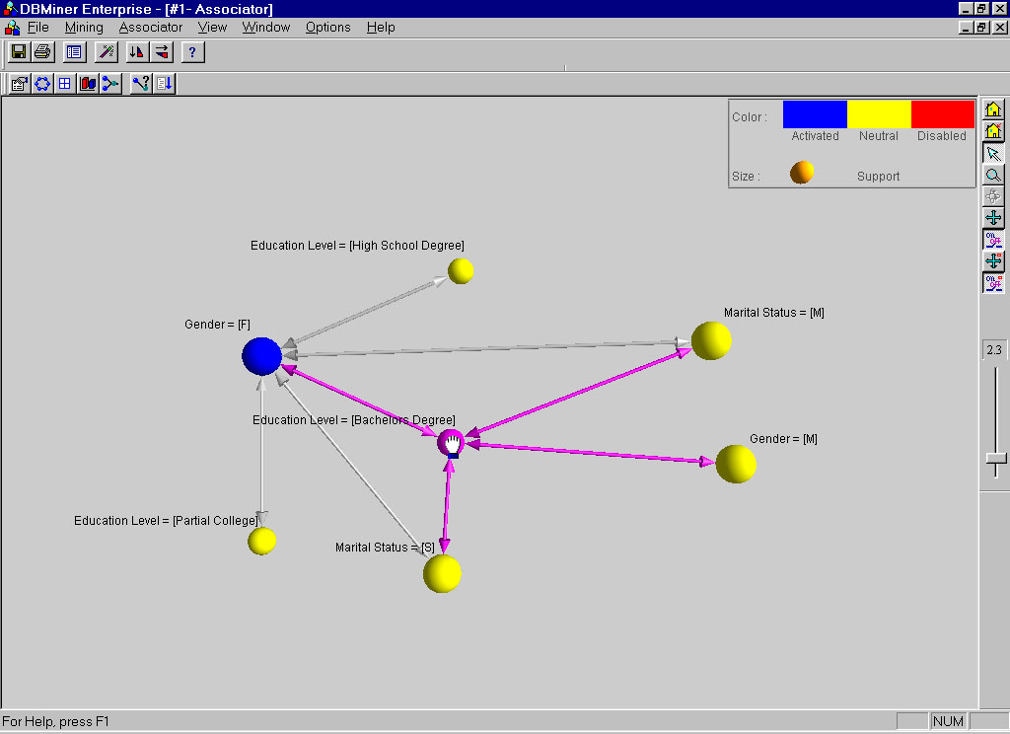
Visualization of Association Rules: Rule Graph

Slide 95
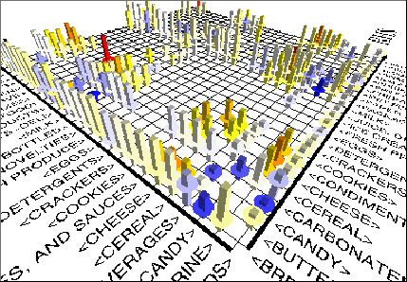
Visualization of Association Rules (SGI/MineSet 3.0)

Slide 96
Chapter 5: Mining Frequent Patterns, Association and Correlations: Basic Concepts and Methods
Basic Concepts
Frequent Itemset Mining Methods
Which Patterns Are Interesting?—Pattern Evaluation Methods
Summary

Slide 97
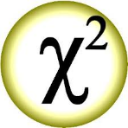
Which Patterns Are Interesting? Pattern Evaluation Methods
Even though the Support and confidence measures exclude the exploration of a good number of uninteresting rules but still many of the rules generated are of no use by user.
Its true when support thresholds is low or
Mining for long patterns.
So it has been a major bottleneck for mining association rules of users interest.
therefore we need other supplementary factors in conjunction with support and confidence. i.e lift and Chi-square (x²)

Slide 98
Strong rules are not necessarily interesting
Whether or not a rule is interesting can be assessed either subjectively or objectively
Subjective means users judgment
Objective depends on statistics behind the data
A misleading Strong Association rule Example:
Analysis of purchase of computer games and videos
6000/10,000 transactions are of games s=60%
7500/10,000 transaction are of videos s=75%
4000/10,000 transactions have both s=40%

Slide 99
Strong rules are not necessarily interesting
The association rules discovered by using min_sup=30%
{Games} → {Videos} [40%, 66%]
Probability of video purchased i.e 75%, its larger than 66%
In fact games and videos are negatively associated/correlated
Without known this reality and just on the basis of support and confidence frameworks the business decision can be made unwisely on above association rule.
Hence we can say correlation has also an importance in finding interesting association rules.
Lift and chi-square can measure correlation.

Slide 100
LIFT
Example
6000/10,000 transactions are of games s=60%
7500/10,000 transaction are of videos s=75%
4000/10,000 transactions have both s=40%
Lift (A,B) = P(A U B)/P(A)P(B)
Lift (Games,Videos)= P(G U V)/P(G)P(V)
Lift (Games,Videos)= (0.4)/(0.6*0.75) = 0.89
Negative correlation because value is less than 1.

Slide 101
Interestingness Measure: Correlations (Lift)
play basketball ⇒ eat cereal [40%, 66.7%] is misleading
The overall % of students eating cereal is 75% > 66.7%.
play basketball ⇒ not eat cereal [20%, 33.3%] is more accurate, although with lower support and confidence
Measure of dependent/correlated events: lift
 | Basketball | Not basketball | Sum (row)
Cereal | 2000 | 1750 | 3750
Not cereal | 1000 | 250 | 1250
Sum(col.) | 3000 | 2000 | 5000

Slide 102
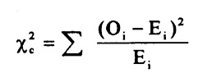
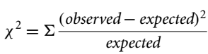
Chi-Square (χ² ) Method
To compute it, we take the squared difference between the observed and expected value for a slot (A and B pair) in the contingency table, divided by the expected value.

Slide 103
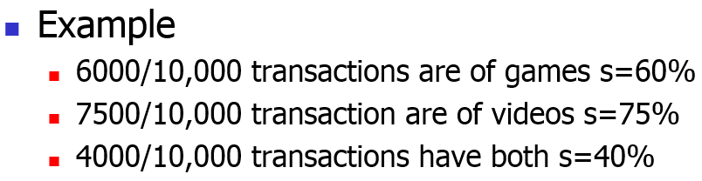
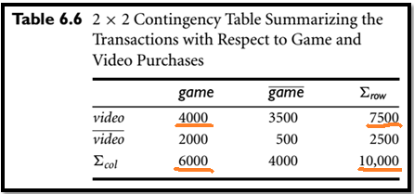
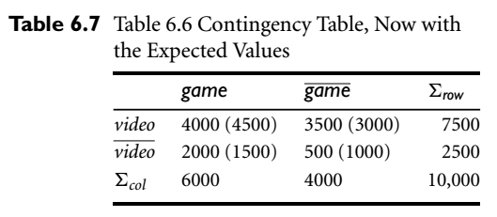
Example
Expected Value (E) =
(Row Total * Col Total)/N
E=7500*6000/10000 = 4500
E = 2500*6000/1000 = 1500
and so on

Slide 104

Expected Value (E) = (Row Total * Col Total)/N
E=7500*6000/10000 = 4500
E = 2500*6000/1000 = 1500
and so on
Notes:
Expected Value (E) = (Row Total * Col Total)/N

Slide 105


See videos
H₀ = Null hypothesis = no correlation between game and video
H₁ = Alternative hypothesis = Yes correlation between game and video
Degree of significance Alpha α let assume is 0.05
Alpha lies b/w 0.01 to 0.05
Aplha is area in tail (Blue area)
Find Degree Freedom df = (# row-1)( # col-1)
So here is df=(2-1)(2-1)=1
See chi-square table for Critical value C.V = 3.841
X² > C.V means lies in yellow region so Ho is rejected and H1 is accepted

Slide 106


Slide 107




Recent Pattern Evaluation Measures
All confidence
Max-Confidence
Kulczynski
Cosine:
Harmonized lift

Slide 108

Are lift and χ² Good Measures of Correlation?
“Buy walnuts ⇒ buy milk [1%, 80%]” is misleading if 85% of customers buy milk
Support and confidence are not good to indicate correlations
Over 20 interestingness measures have been proposed (see Tan, Kumar, Sritastava @KDD’02)
Which are good ones?

Slide 109

Null-Invariant Measures

Slide 110


Comparison of Interestingness Measures
Null-(transaction) invariance is crucial for correlation analysis
Lift and χ² are not null-invariant
5 null-invariant measures
 | Milk | No Milk | Sum (row)
Coffee | m, c | ~m, c | c
No Coffee | m, ~c | ~m, ~c | ~c
Sum(col.) | m | ~m | Σ
Null-transactions w.r.t. m and c
Kulczynski measure (1927)
Null-invariant
Subtle: They disagree

Slide 111

Analysis of DBLP Coauthor Relationships
Recent DB conferences, removing balanced associations, low sup, etc.
Advisor-advisee relation: Kulc: high, coherence: low, cosine: middle
Tianyi Wu, Yuguo Chen and Jiawei Han, “Association Mining in Large Databases: A Re-Examination of Its Measures”, Proc. 2007 Int. Conf. Principles and Practice of Knowledge Discovery in Databases (PKDD'07), Sept. 2007

Slide 112
Which Null-Invariant Measure Is Better?
IR (Imbalance Ratio): measure the imbalance of two itemsets A and B in rule implications
Kulczynski and Imbalance Ratio (IR) together present a clear picture for all the three datasets D₄ through D₆
D₄ is balanced & neutral
D₅ is imbalanced & neutral
D₆ is very imbalanced & neutral

Slide 113

Assignment #1
Marks 5, Submission date: 20/03/2017 (Mon)

